Slide 2
Candidates for review and possibly a revision
Throughput time prediction model
Can this be made more or less accurate?
If we are simulating multiple instances of the same situation, the prediction model performance would likely also differ from time to time
I have asked Gemini to review if there is a way we can make the performance better or worse
It is likely not taking into account the very low R2
Can we increase the R2 for this model?
What is the “prior” of the waiting time before there has been an interaction with the system? Can we manipulate this, and make it more predictable?

Slide 3
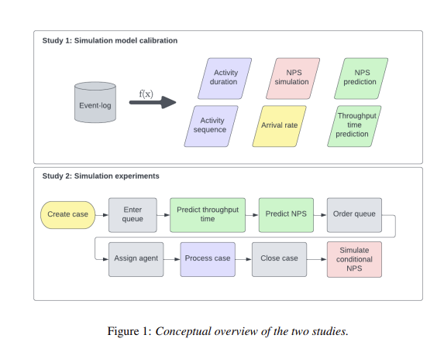
Studies in v1 paper

Slide 4
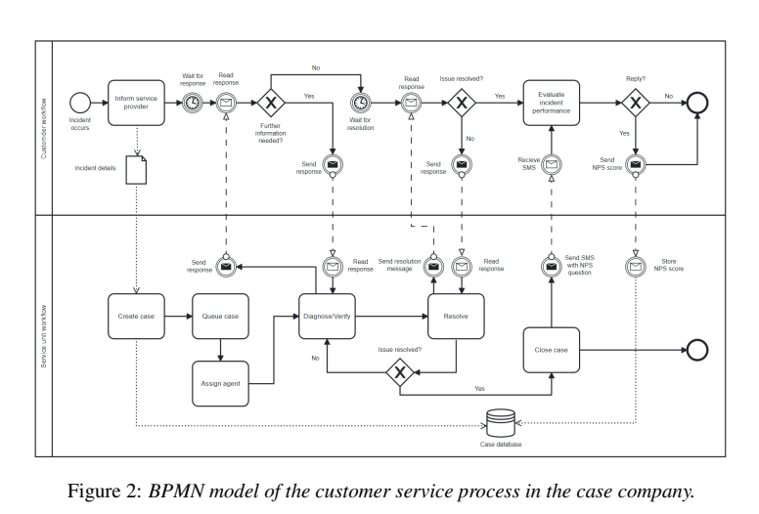
Process

Slide 5
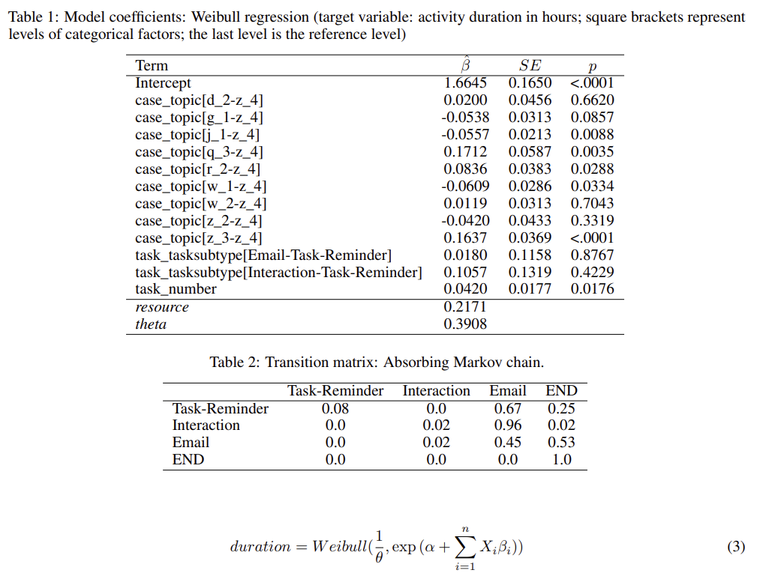
Activity duration

Slide 6
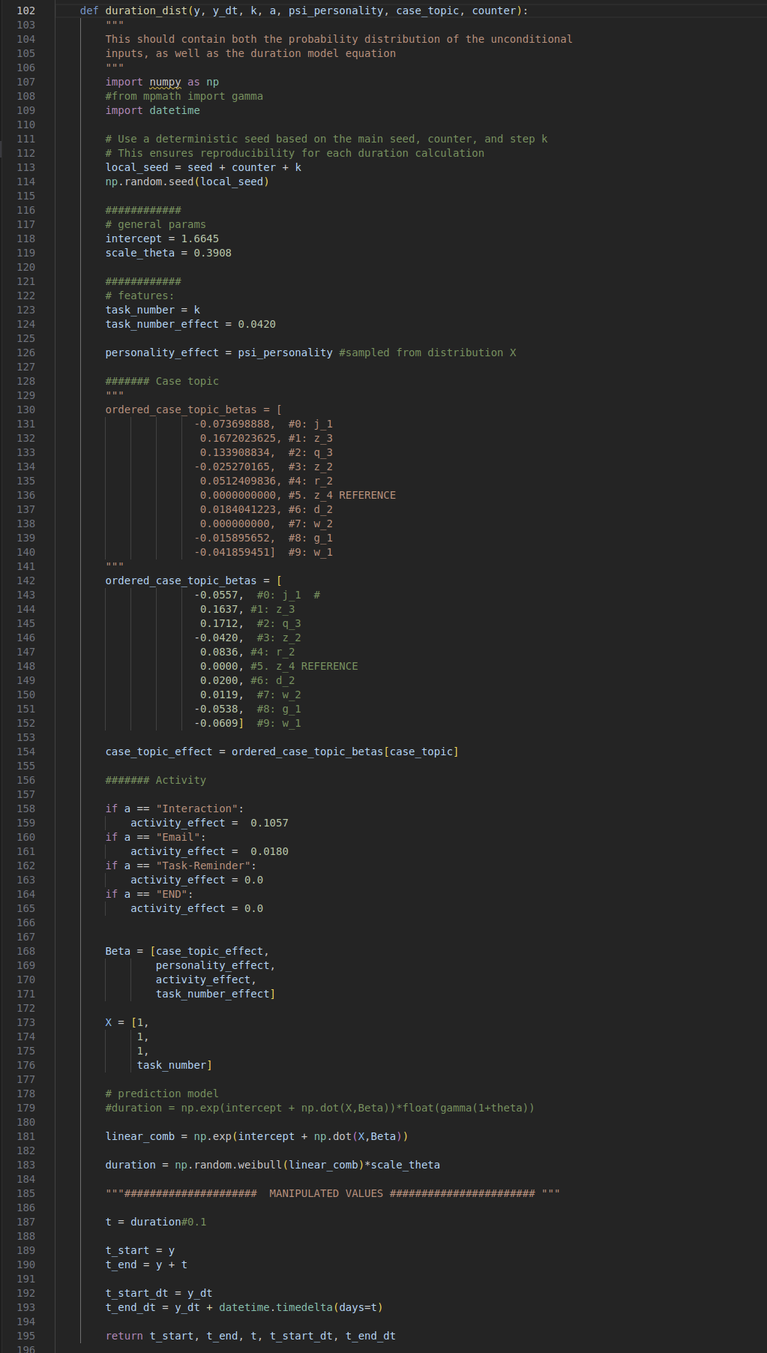

Slide 7
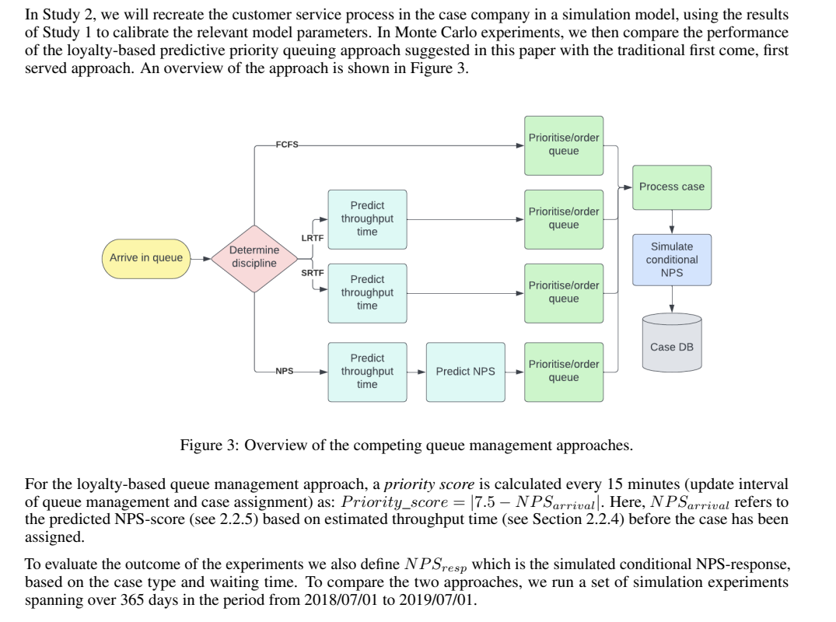
Simulation approach

Slide 8
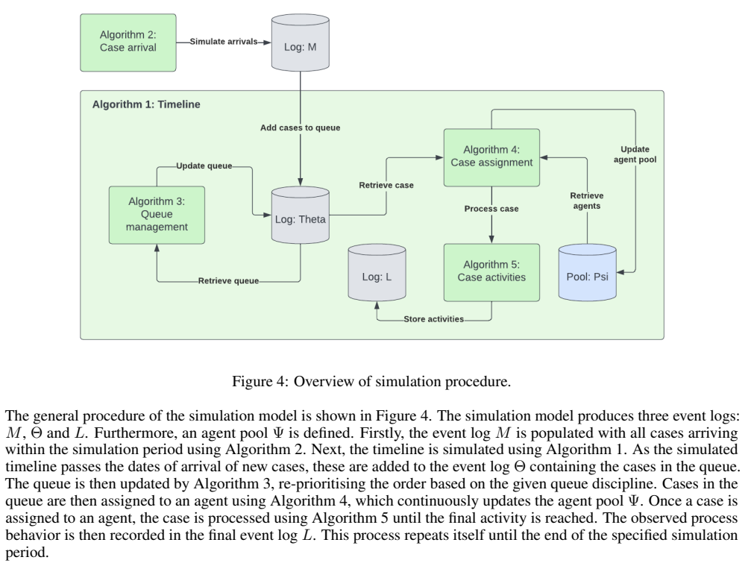
Simulation process
Predict TT
Predict NPS
Prioritize
Sim. Topic

Slide 9
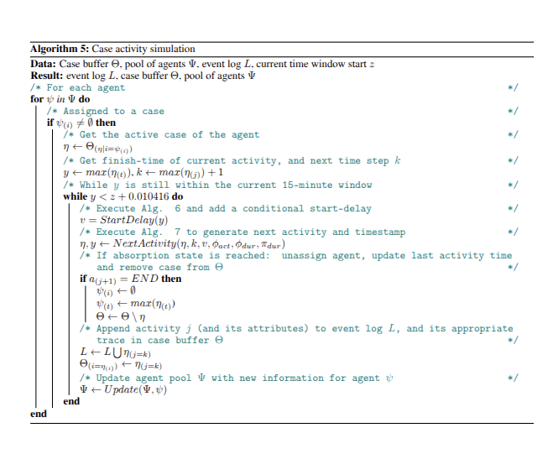

Slide 10
Notes on changes:
Added parameters to NPS simulation model
Additive Bias of the distribution
Multiplier effect of TT on NPS
Adding a stochastic component to TT prediction model;
To be able to control predictability of TT
As prediction performance will vary across simulation runs (adding a bias?)

Slide 11
Way forward: May 22
GOALS
Change the model to approximate a B2C process instead, where it is known that TT has a stronger influence on NPS
Increase the signal between TT and NPS
TODOS
Change winsorizing to Quantile binning for NPS simulation model (need a mode at 7-8, but the whole distribution needs to change)
Need to further change the shape of the distribution (via quantile binning) to make sure everyone isnt perfectly happy already
Number bins = 11 (0, 10)
Change TT simulation model by reducing the noise component:
Change simulation equation to a linear model with log TT
When simulating;
add the multiplicative NPS bias with factors of 100

Slide 12
New TT prediction model
Fit on attributes that we assume to be known to us;
And the simulated TT distribution

